Slide 1

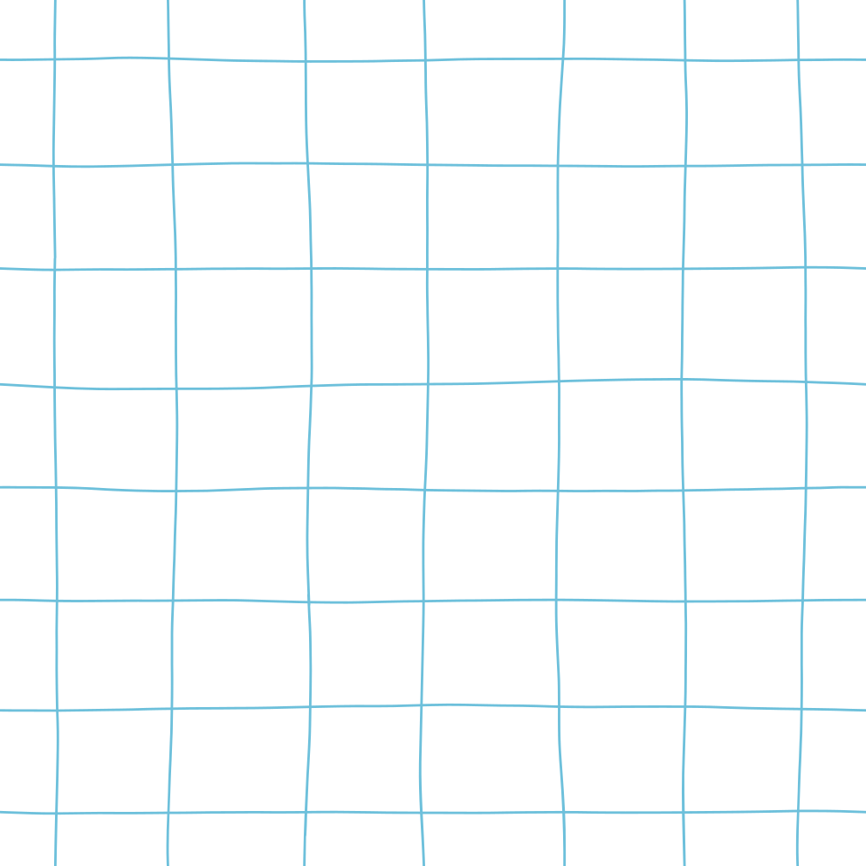

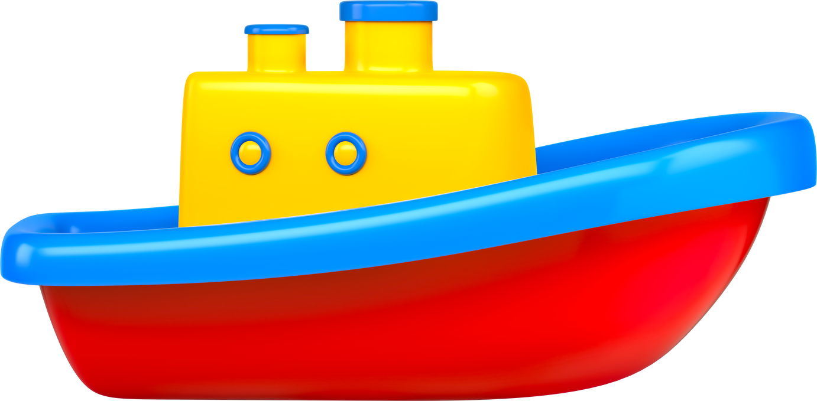
Will it Float?

Slide 2
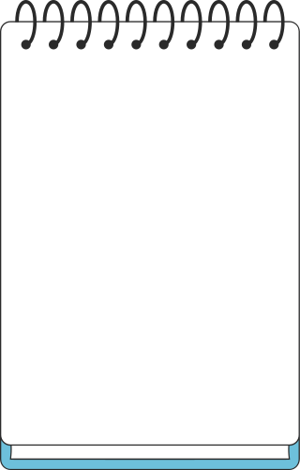
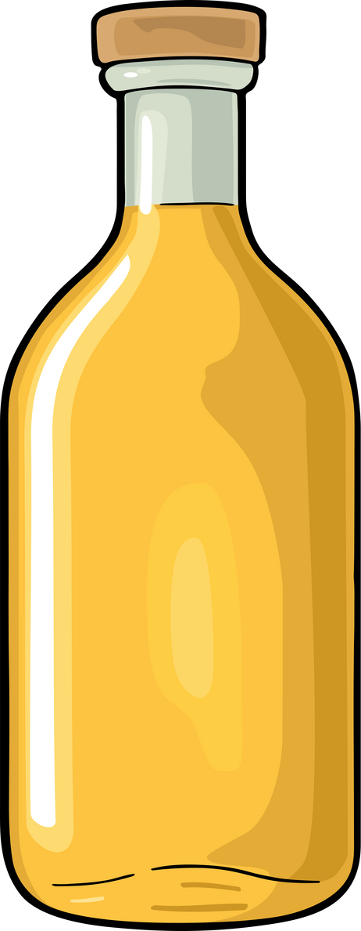
Plastic Bottle

Slide 3
Plastic Bottle
YES

Slide 4

Beach Ball

Slide 5
Beach Ball
YES

Slide 6
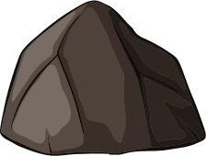
Rock

Slide 7
Rock
NO

Slide 8

Wood

Slide 9
Wood
YES

Slide 10

Coins

Slide 11
Coins
NO

Slide 12

Spoon

Slide 13
Spoon
NO

Slide 14
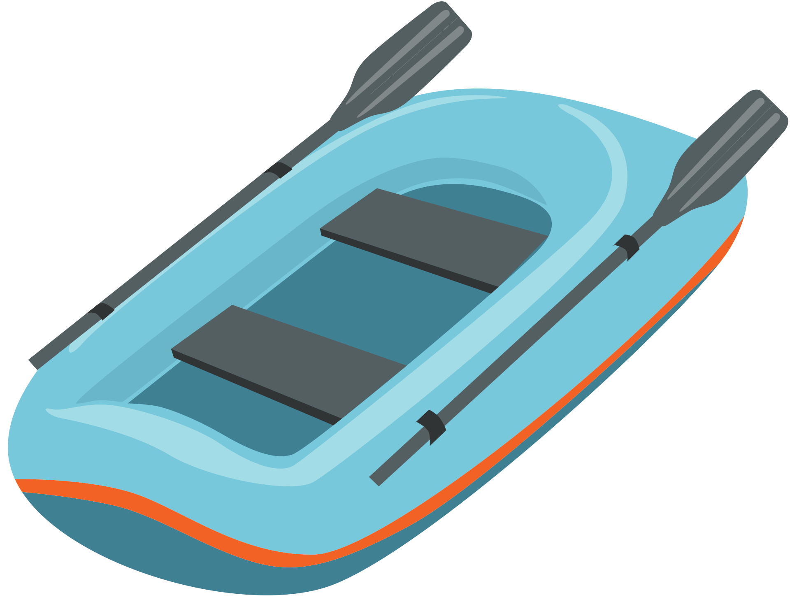
Rubber Boat

Slide 15
Rubber Boat
YES

Slide 16

Leaf

Slide 17
Leaf
YES

Slide 18

Oil

Slide 19
Oil
YES

